Slide 1
IS IT WORTH RESPONDING TO REVIEWS?
Studying The Top Free Apps in Google Play
Submitted By:
Samhitha Tummanapalli (Class ID : 45)
Swati Singh (Class ID : 38)
Zeenat Tariq(Class ID : 42)
Sayed Khushal Shah(Class ID : 34)

Slide 2
Introduction
App stores allows users provide feedback in two ways:
Five-star system
Writing short comments
It’s important to address user’s feedback - done by personally responding to particular user review which motivate users to increase ratings.
Strategic choice has to be made to respond to types of reviews.
In many cases, the responses led to improved ratings.

Slide 3
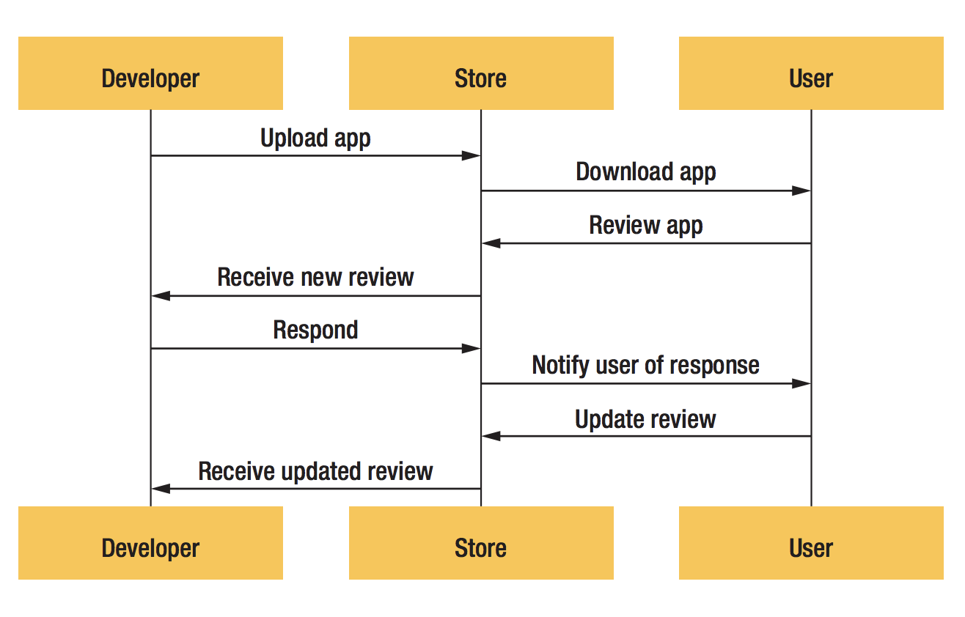

Slide 4
The DATA
Google play is chosen by the authors for the research because of its popularity.
It allows to respond to reviews and tools are available to automatically collect information.
Top apps are the focus of the research because:
They have many reviews
Developers focus on maintaining and growing apps’ user base
More profitable

Slide 5
Data SELECTION
Selected 12,000 top free-to-download apps from 30 categories like photography, sports and education.
Selection is based on the US app rankings by Distimo which is an analytics company.
Distimo’s spring 2013 top-app list is used.
The chosen apps were popular an year before because they would be more stable, mature.

Slide 6
DATA COLLECTION
Crawler was developed to extract information like app names, user ratings and review comments.
It simulates a mobile device Samsung Galaxy S3 as it was most popular then.
It was modified to gather information relevant to study.
Timer was installed as it helps to pause the crawler to avoid many requests.
It was scaled over multiple machines to distribute load.

Slide 7
Continued…
Crawler ran from 1 January, 2014 to 2 March, 2014
1287 apps were not accessible – data was collected from 10,713 apps.
On average, an app had 0.86 releases.
Not all stores provide access to all their reviews.
Only 500 latest reviews per app are accessible.

Slide 8
Analyzing the Data
MANUAL ANALYSIS
AUTOMATED ANALYSIS
RESULTS

Slide 9
MANUAL ANALYSIS
Manually labeled a statistically representative sample of 384 reviews from the top apps, using the 17 topics Dennis Pagano and Walid Maalej observed in the Apple App Store.
Also manually labeled the responses from the 111,099 reviews that had them. Because Pagano and Maalej did not study the topics of responses, authors followed an iterative process to discover those topics until they found no additional topics.
They needed the number of reviews and responses that would provide a statistical sample with a 95 percent confidence level and a 5 percent confidence interval.
Single review or response could contain more than one topic.
Manually analyzing and labeling each review and response took approximately eight hours. One of the authors reviewed the labels for consistency. If the other coauthors initially disagreed (which occurred for very few reviews), they reached a consensus.

Slide 10
AUTOMATED ANALYSIS
Automated analysis calculated the average rating change for reviews with responses, and the change’s probability and magnitude.
Then separated the reviews into 25 automatically generated topics, using latent Dirichlet allocation (LDA),3 and examined which topics most likely led to a positive change.
Choice of topics was motivated by the desire for broad, general topics that most developers would deal with.
We chose 25 to ensure that the number of topics was large enough to cover the 17 topics from Pagano and Maalej.
From 7 to 27 April, we monitored whether any ratings, review comments, or responses changed. An initial review and all subsequent related changes constituted a review chain. We automatically analyzed 15,208 review chains. The median chain length was 2 (one review and one response); the maximum length was 8.

Slide 11
RESULTS: AUTOMATED ANALYSIS
The developers of only 13.8 percent of the 10,713 apps responded.
As Figure shows, the developers of apps with a greater number of downloads tended to not respond, but the developers of some apps in the middle range of the number of downloads responded often.
The apps with high response percentages had a low number of reviews
We found that 38.7 percent of the users increased their rating after a response; the median increase was one star .
Developers can benefit from responding to reviews. Some users even updated their review to notify the developer that the response had solved their problem or to thank the developer for responding to them.

Slide 12
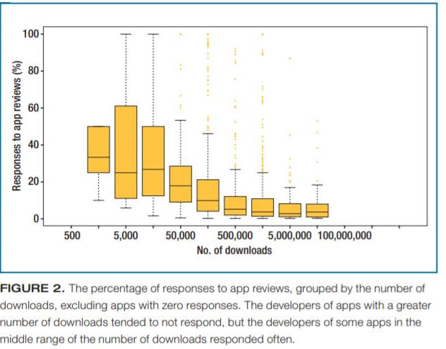

However, the fact that so few developers responded suggests that developers might not realize that responding provides such benefits.
Moreover, the average rating for the apps whose developers did not respond was only 1.7 stars. Such a low rating suggests that these apps need a chance to increase their rating by having their developers respond. Also, most reviews with responses had low ratings, with an average of 2.2 stars.
This supports prior research that targeted negative (1- and 2-star) reviews as being of greater interest and concern to mobile-app developers than positive reviews.4–6 .

Slide 13
CONTD..
The most common topic that received responses was crashing (8 percent). Crashing is a serious problem and greatly affects the user experience. It is understandable that developers focus on reviews mentioning crashes.
The chance of an improved rating for each topic mentioned in a review ranged from 15 to 42 percent. The two topics with highest chance of an improved rating were notifications and not being able to connect to the app. These are specific issues that developers can address. Users who wrote reviews concerning problems associated with a specific Samsung phone were the most likely to provide a more positive review following a response. The responses gave specific advice about the phone.
The most common responses (7 percent) involved developers notifying users that a requested feature was either in development or planned. However, the responses with the highest chance of an improved rating (39.1 percent) notifed users that the developers had resolved the problems about which the users had complained.

Slide 14
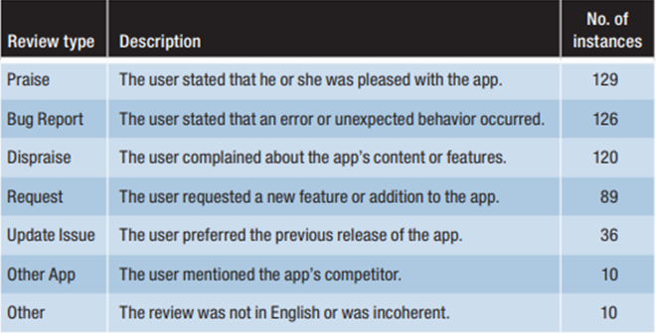
Manual Analysis

Slide 15
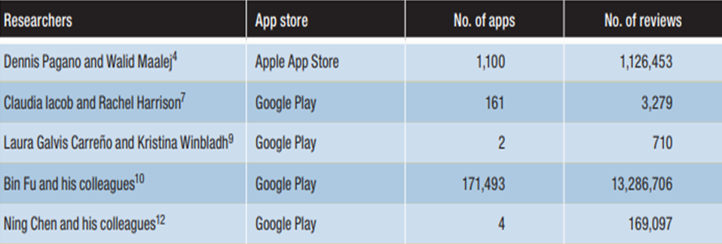
Previous Research
User reviews have a major impact on a mobile app’s success

Slide 16
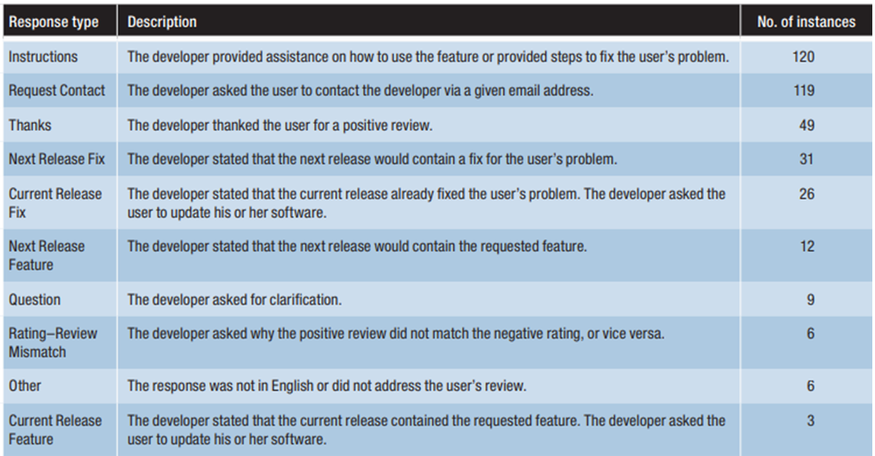
Types of Responses

Slide 17
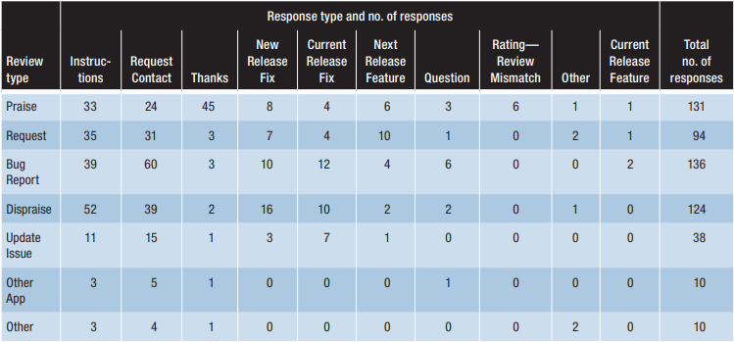
Coupling Review Types with Response Types

Slide 18
Threats to Validity
Construct Validity
Internal Validity
External Validity

Slide 19
Construct Validity
Latent Dirichlet Allocation (LDA) might not produce optimal results when applied to short text such as app reviews
However, research showed that it can successfully extract topics from tweets
During manual analysis, there might have some incorrectly labelled reviews
To mitigate this threat labeling iteratively was performed going over each review multiple times to ensure correct labeling

Slide 20
Internal Validity
Some reviews might be spam. To prevent such spam, Google Play users must log in using their Google ID before reviewing
The authors believe that spam reviews had minimal impact in their study
Future studies should evaluate how spam reviews affected previous research that mined reviews

Slide 21
External Validity
The selection of the top apps could bias the results
Even so, given the large number of unsuccessful and spam apps in Google Play, the author’s study of top apps is warranted instead of blindly studying all apps (free apps)
Paid apps might have different reviews and patterns
Many free apps have in-app purchase features
Such apps need to consider the value of reviews for financial reasons

Slide 22
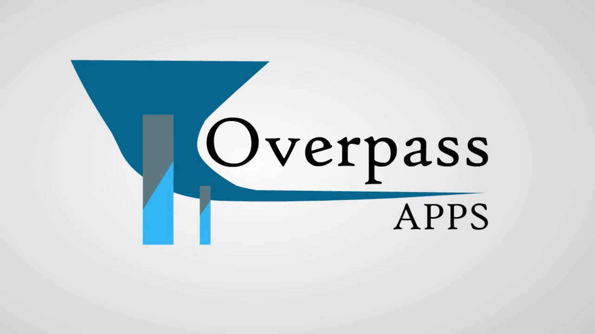
Importance of Customer Review Feedback

Slide 23
References
M. Harman, Y. Jia, and Y.Z. Test, “App Store Mining and Analysis: MSR for App Stores,” Proc. 9th IEEE Working Conf. Mining Software Repositories (MSR 12), 2012, pp. 108–111
D. Pagano and W. Maalej, “User Feedback in the AppStore: An Empirical Study,” Proc. 21st IEEE Int’l Conf. Requirements Eng. (RE 13), 2013, pp. 125–134
C. Iacob and R. Harrison, “Retrieving and Analyzing Mobile Apps Feature Requests from Online Reviews,” Proc. 10th Int’l Workshop Mining Software Repositories, 2013, pp. 41–44
L.V. Galvis Carreño and K. Winbladh, “Analysis of User Comments: An Approach for Software Requirements Evolution,” Proc. 2013 Int’l Conf. Software Eng. (ICSE 13), 2013, pp. 582–591
. B. Fu et al., “Why People Hate Your App: Making Sense of User Feedback in a Mobile App Store,” Proc. 19th ACM SIGKDD Int’l Conf. Knowledge Discovery and Data Mining (KDD 13), 2013, pp. 1276–1284
N. Chen et al., “AR-Miner: Mining Informative Reviews for Developers from Mobile App Marketplace,” Proc. 36th Int’l Conf. Software Eng. (ICSE 14), 2014, pp. 767–778

Slide 24
Thank you

